Slide 1
Welcome!!
Foundation curriculum meeting
1st October 2025

Slide 2
Agenda for the evening
We will inform you of the areas of learning in the Early Years Curriculum
Provide more detail on how we teach early phonics, reading and number.
There will be time at the end for your questions but also feel free to ask questions throughout the meeting.
Notes:
Although this is a Literacy and Numeracy meeting we feel strongly that you need to know about all areas of our curriculum as they are all interlinked.

Slide 3
The Early Years Curriculum
It consists of 7 areas of learning:
Communication and language
Personal, social and emotional Development
Physical Development
Mathematics
Literacy
Expressive arts and design
Understanding the world
Notes:
Handouts on table displaying the ELGs for then end of the year

Slide 4
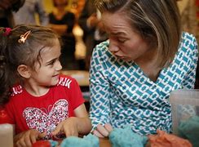



Communication and Language
Express and explain their ideas
Engage in conversation
Use and apply new vocabulary
Listen and respond
Ask questions
Understand and make links
Notes:
At home you can
Take time on an activity and work together
Take time to time to talk together
Tell them a story orally rather than always have a book
Discuss, respond to and recall stories
Relate new ideas to previous knowledge or visits
Encourage the language of questioning, how, what, when, who? (why always seems to be well known!!)

Slide 5

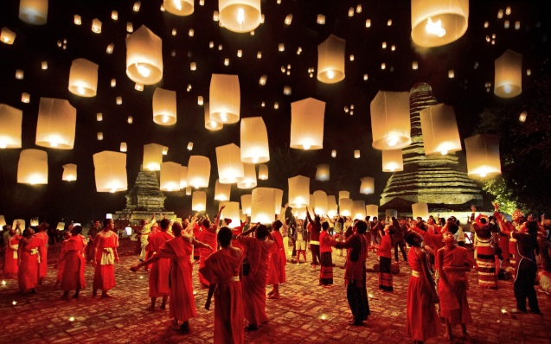
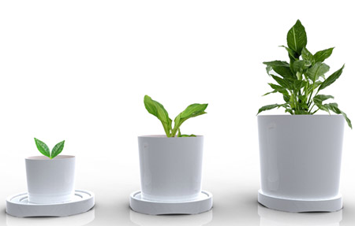

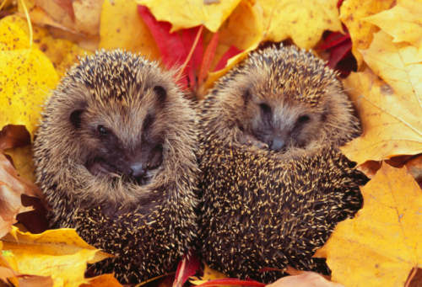
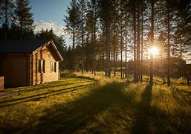
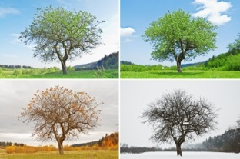
Understanding the World
Celebrations
Growth
Beliefs
Learning facts and vocabulary
Nature
Recall past events
Changes
Notes:
Science: investigative skills
ICT: Uses a range of technology in their learning
History: can talk about now and then
Geography
RE: different people have different beliefs
Design and Technology: builds for a purpose, selects the right resources and makes amendments
At home:
Go out and about exploring different places
Spend time with adults doing DIY etc.., asking questions and finding out about different tools.
Access to computers and technology around the home e.g. help to use the microwave
Use Education city (will talk about this later)
Look at old photos, spend time talking to grandparents
How do things change e.g. materials, weather, animals, people etc.
Watch documentaries on television
Discuss celebrations, why and how do we celebrate different things e.g. weddings, christenings
Discuss special events from own and other cultures
Discuss differences and expectations in different households/places e.g. Taking shoes off, saying grace before eating

Slide 6
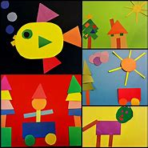

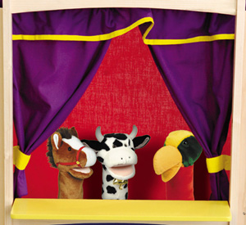
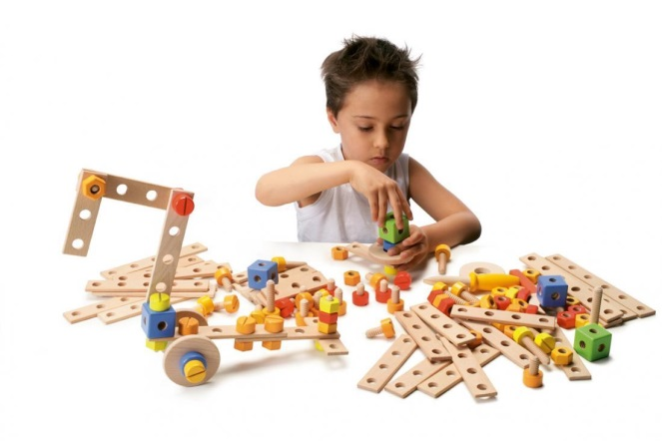
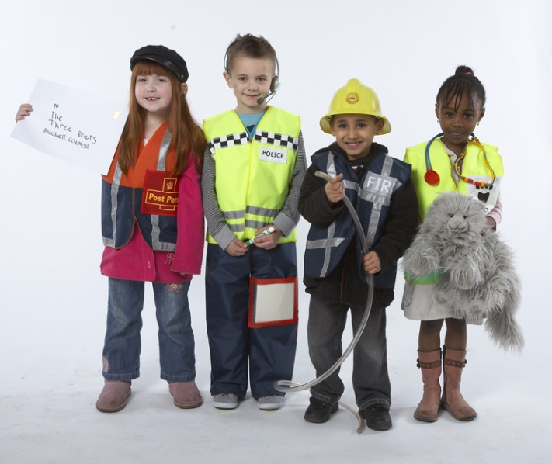

Expressive arts and design
Puppets
Music
Art
Construction
Performing
Role play
Notes:
Art, music and drama
At home
Provide resources to explore
Songs and music
Junk modelling
Painting, drawing etc..
Role play resources
Dressing up
Out of school clubs such as dancing, drama

Slide 7
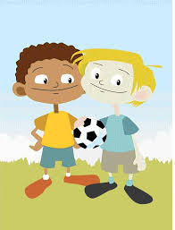
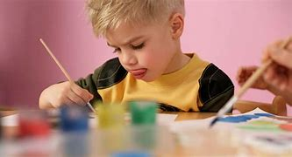

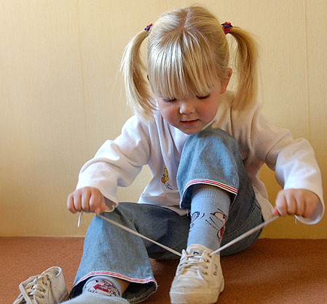
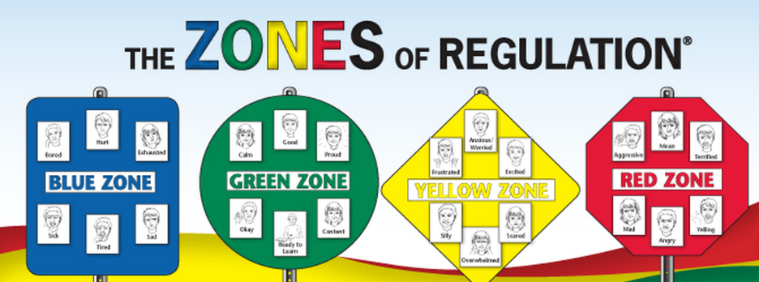
Personal, social and emotional development
Focus and attention
Relationships
Health and hygiene
Friendships
Understand feelings
Independence
Notes:
At home you can
Encourage them to try new things
Have friends over
Play games together
Go out to places to meet other children
Possibly have home rules to follow
Read stories and highlight the feelings of characters or how children feel about the story
Share their achievements on the classroom WOW board

Slide 8
Zones of Regulation
The Yellow Zone is used to describe a heightened state of alertness; however a person has some control when in the Yellow Zone. A person may experience stress, frustration, anxiety, excitement, silliness, nervousness, confusion and many more slightly elevated emotions and states when in the Yellow Zone (wiggly or sensory seeking). The Yellow Zone is starting to lose control. When in the Yellow Zone, proceed with caution.
The Green Zone is used to describe a regulated state of alertness. A person may be described as calm, happy, focused, or content when in the green Zone. This is the zone children generally need to be in for school work and being social. Being in the Green Zone shows control. The Green Zone you are “ good to go”.
The Blue Zone is used to describe low states of alertness, such as when a child feels sad, tired, ill, or bored. This is when your body is moving slowly or sluggishly.
The Red Zone is used to describe extremely heightened state of alertness or very intense feelings. A person may be experiencing anger, panic, terror, devastation, or elation when in the Red Zone. Being in the Red Zone can be explained by being overwhelmed by your feelings and having a loss of control.

Slide 9
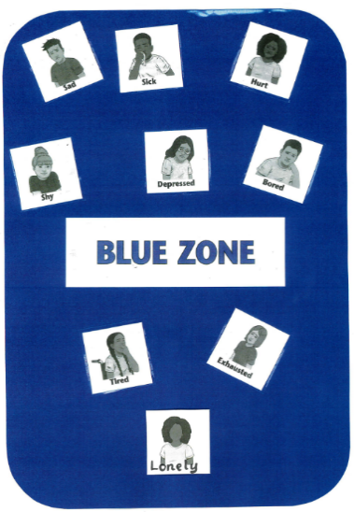
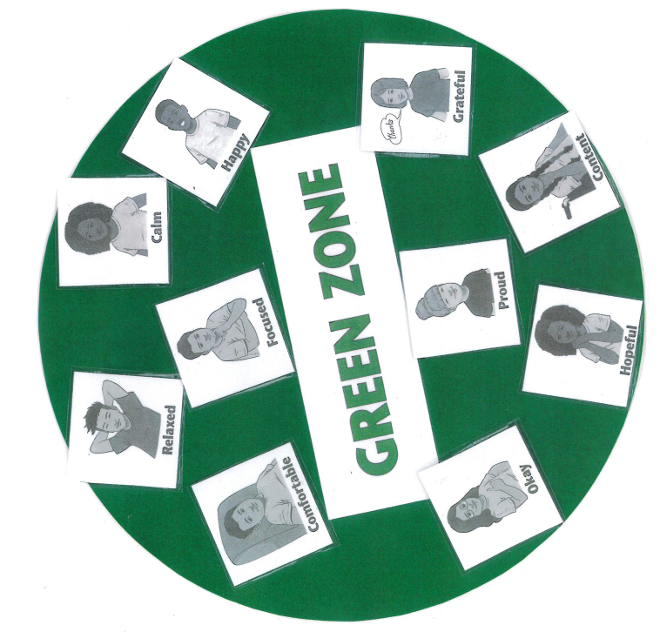
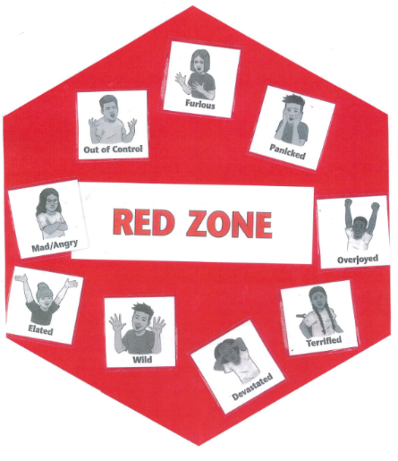
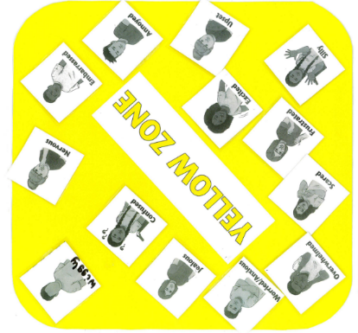
It is normal to move freely between the zones.
It is important to remember that there are no ‘negative’ zones.

Slide 10
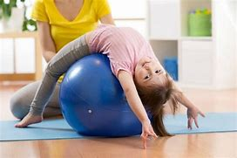
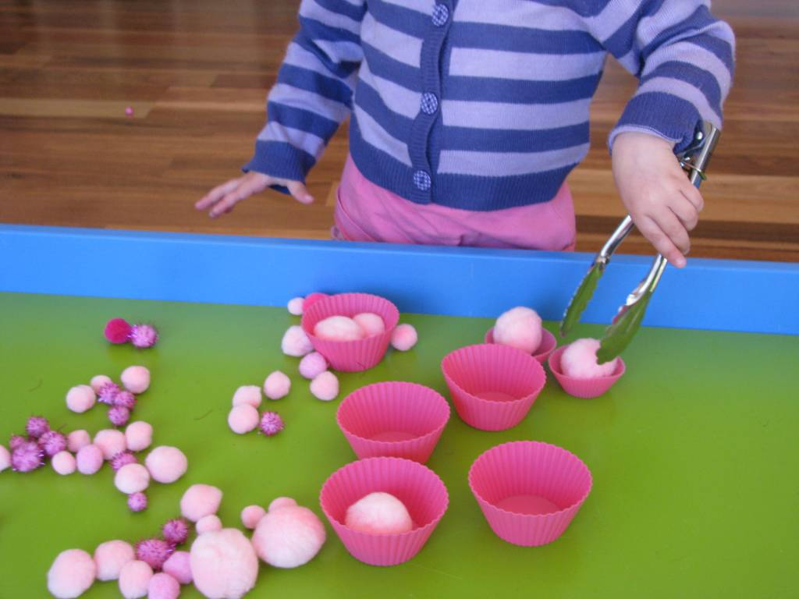
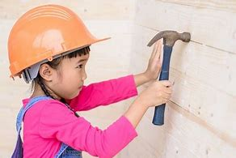
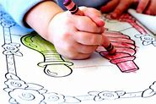

Physical Development
Strength and balance
Fine motor control
Accuracy and care
Handwriting
Tools and safety
Notes:
Go outdoors on bikes, scooters etc.
Go to the park on the climbing frames etc.
Discuss healthy food whilst eating or cooking
Talk about changes to our bodies after running or doing exercise such as sweating or heart beat
Encourage being safe around the home with tools and equipment
Dress themselves or their toys
Dancing to music, creating own dances and actions
Use of play dough, threading, sewing activities

Slide 11
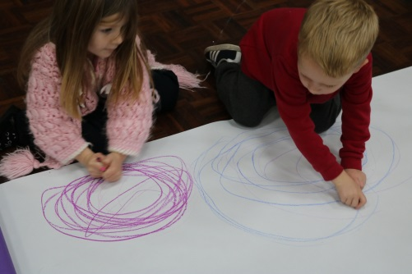

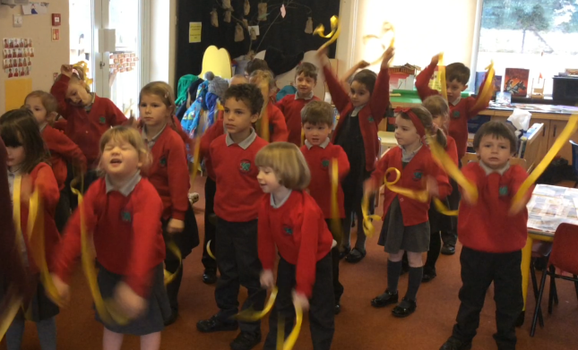

Daily provision in school

Slide 12
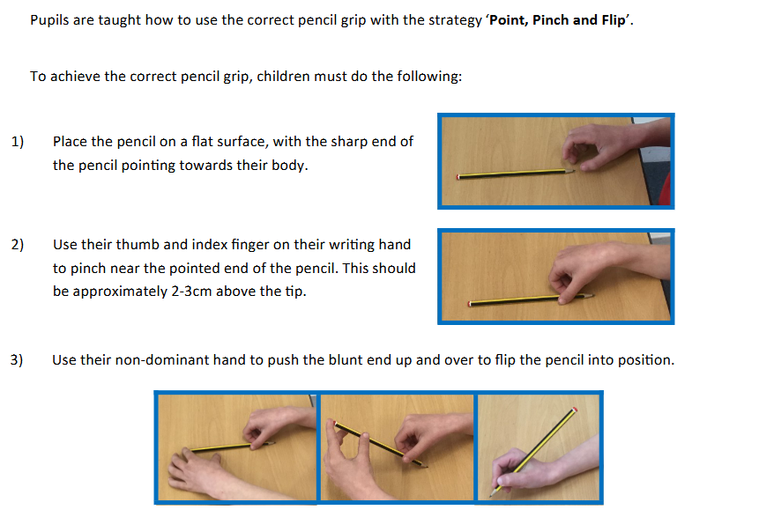
Pencil grip
Let’s have a go!

Slide 13

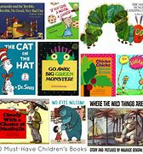
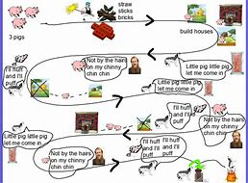
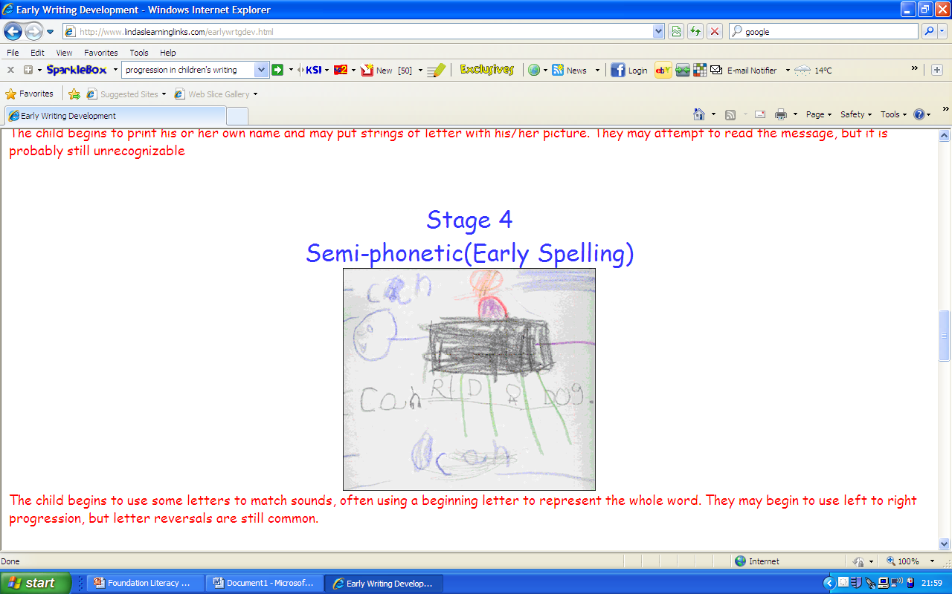
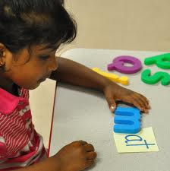
Literacy
Stories and texts
vocabulary
Love of reading
Talk for reading and writing
Phonics

Slide 14

A government validated systematic synthetic phonics programme which each school is required to have.
Children will learn 150+ graphemes (letters) and the corresponding phonemes of the English language as well as common exception words.
This is achieved through daily phonics sessions, guided reading and intervention activities

Slide 15
What Phonics skills does my child learn in Foundation?
Learn to recognise graphemes for all 44 phonemes
To orally blend words ready for reading
To orally segment a word into its individual phonemes
Blend words to read
Segment words for writing
Read CEW by sight
Read and write captions and sentences containing the GPC’s and CEW’s

Slide 16
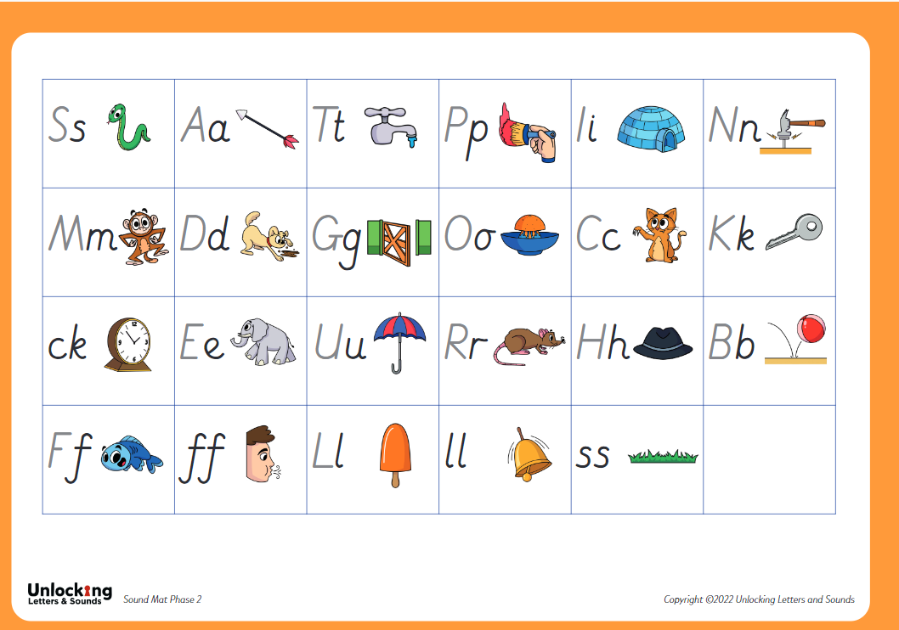

Slide 17
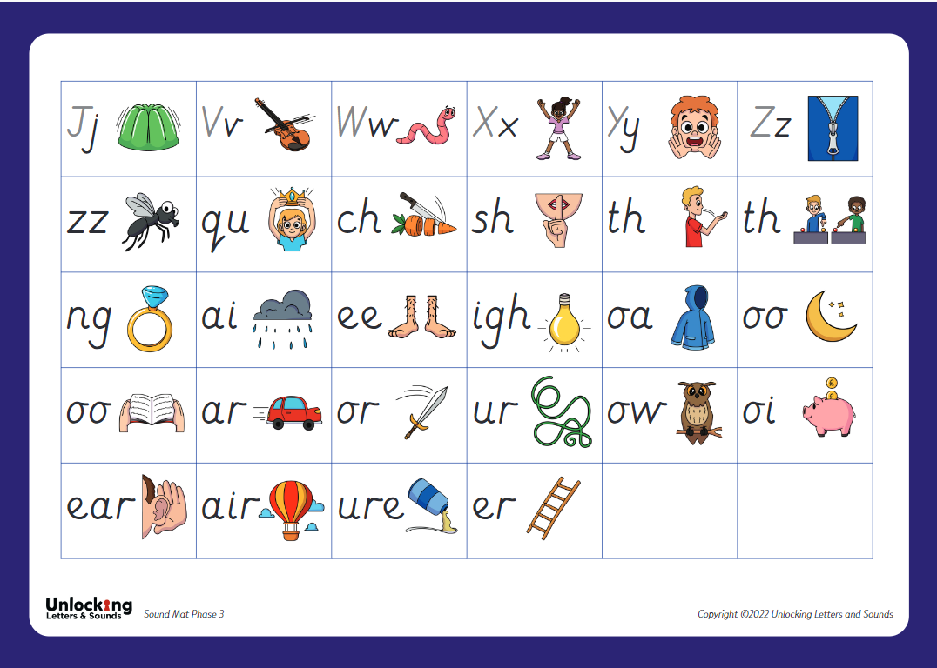

Slide 18
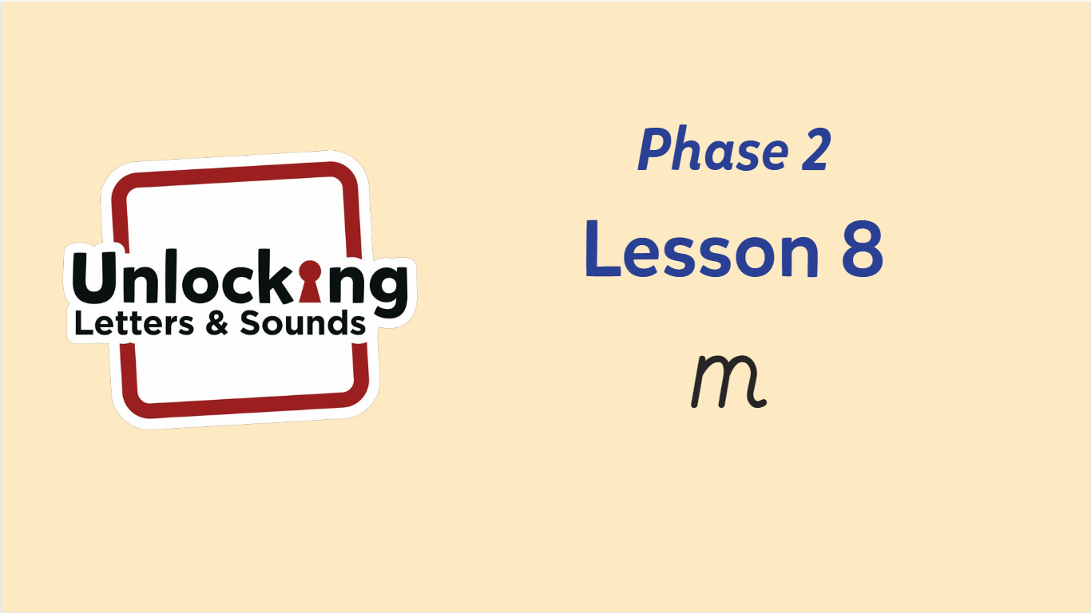
A typical daily phonics lesson

Slide 19
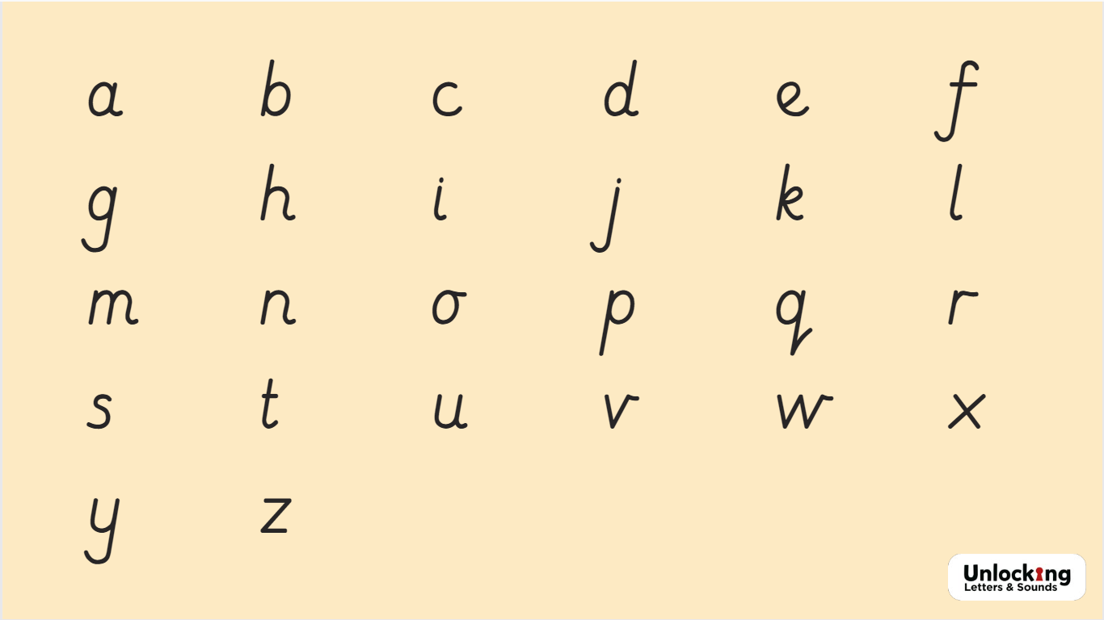

Slide 20


Slide 21


Slide 22


Slide 23


Slide 24


Slide 25


Slide 26


Slide 27


Slide 28


Slide 29


Slide 30
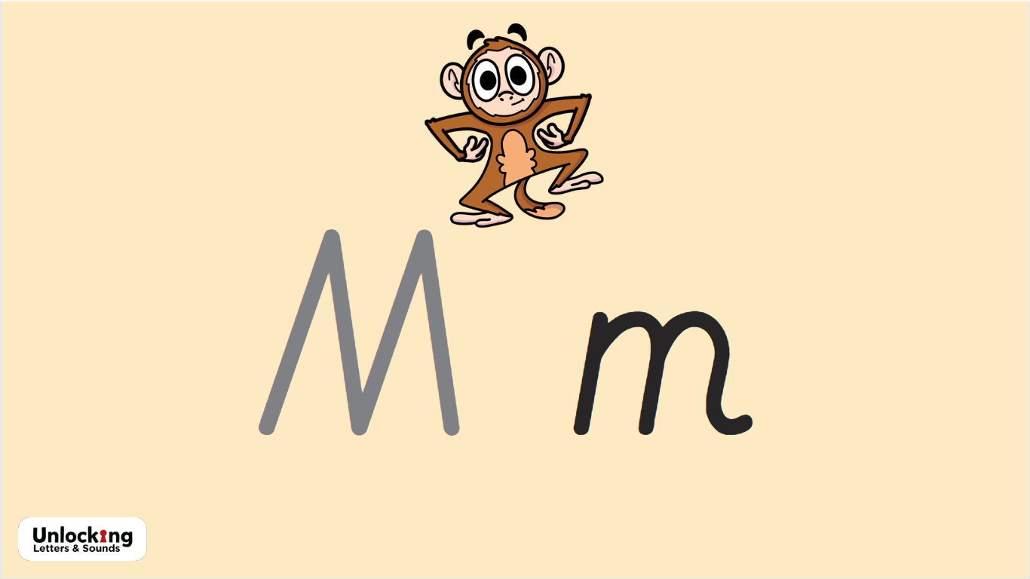

Slide 31


Slide 32


Slide 33
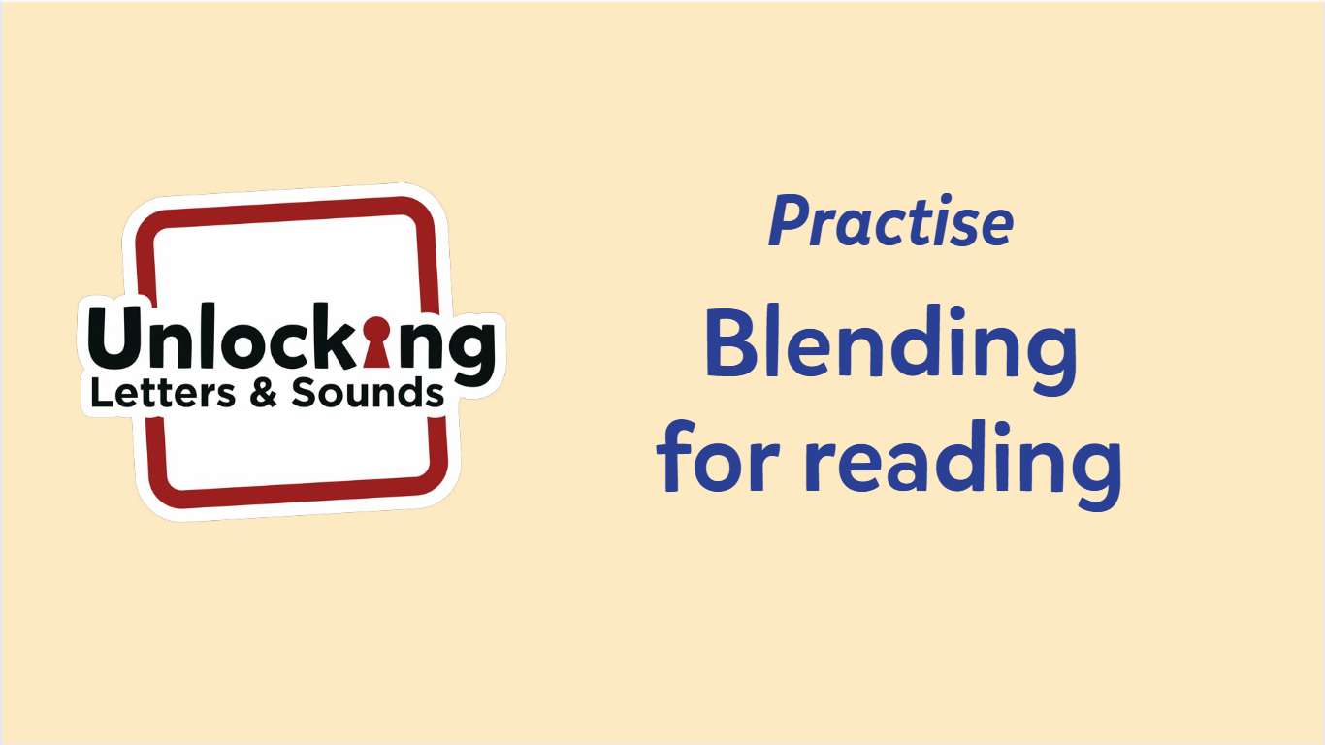

Slide 34


Slide 35
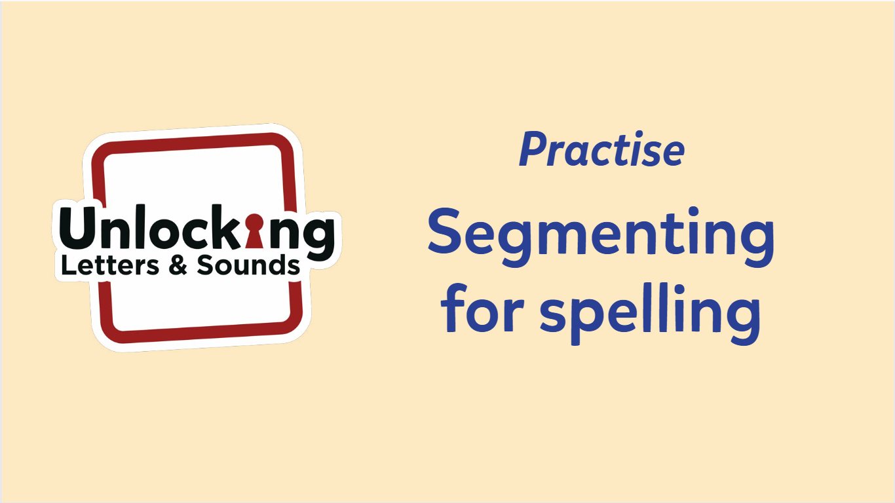

Slide 36


Slide 37


Slide 38


Slide 39


Slide 40


Slide 42
How can you help at home?
Sound strips will be sent home at the end of each week which you can stick in your child's book.
Run through the sound book regularly
Practise oral blending
Share love of reading books and other stories
Listen to your child read their home reading book

Slide 43
Reading in Foundation
This term we will continue to read and share stories on a daily basis
We are sharing known or topic related books in a small group to introduce book talk language and handling skills
In autumn term 2 children will begin to take part in 2 guided reading sessions a week which will be based on a book which they should be able to read with 90% accuracy and fluency
All children have been bringing home a love of reading book which I hope you have been able to enjoy and we will be sending non word books home from next week to develop vocabulary and verbal caption and sentence construction. These will be changed each week so keep them in your child's book bag
Further information and reminders will be sent out when books come home

Slide 44
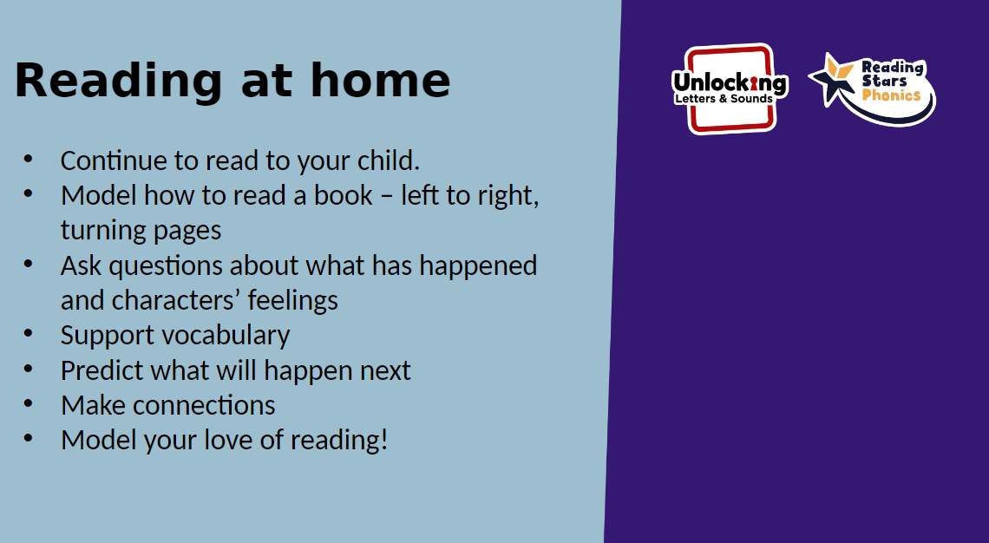

Slide 45
How Number is taught in school:
Daily input or activities.
Language and vocabulary is key
Encouraging children to use sentence stems such as ‘I can see..’… to explain their workings and observations
Always use practical manipulatives and resources
Use everyday objects and scenarios to make maths real.
Use of stories and books to develop and introduce concepts
5 and 10’s frames used from very early on. Encouraging children to recognise numbers without counting and eventually number bonds.

Slide 46
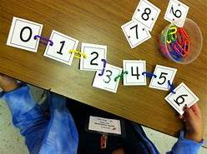
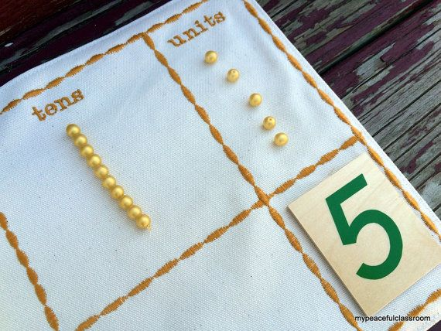
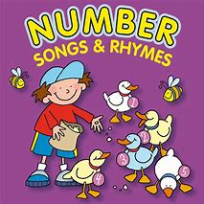
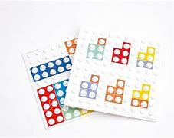
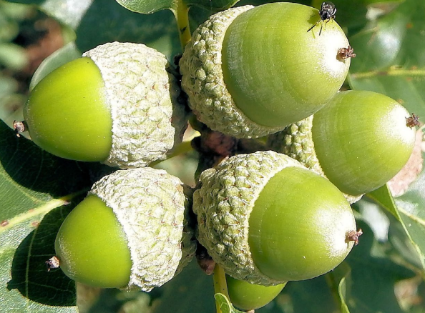
Mathematics: Number
Recognise, order and understand
numbers to 10
composition
Subitise
Recall number bonds to 5

Slide 47
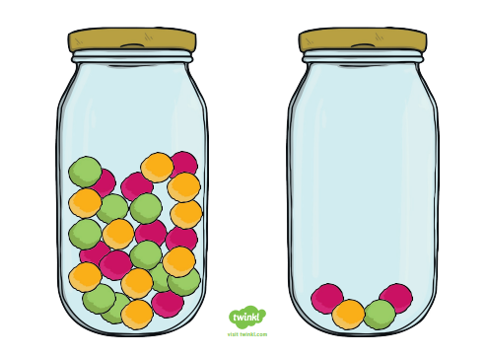
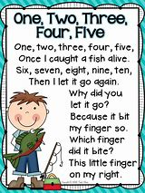
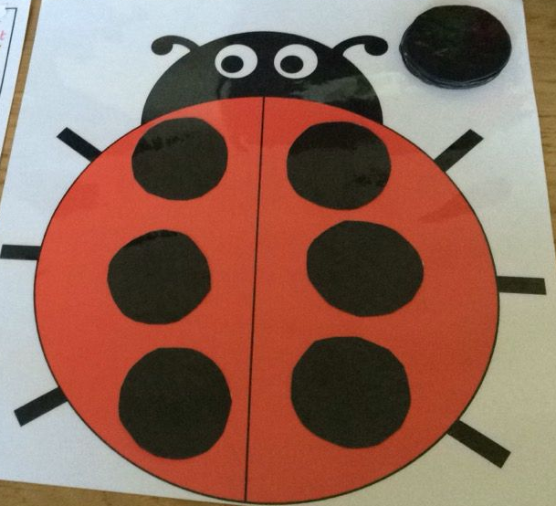
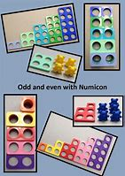
Mathematics: Numerical patterns
Count beyond 20
compare
doubling
Odd and even
Vocabulary: same, less, more, equal

Slide 48
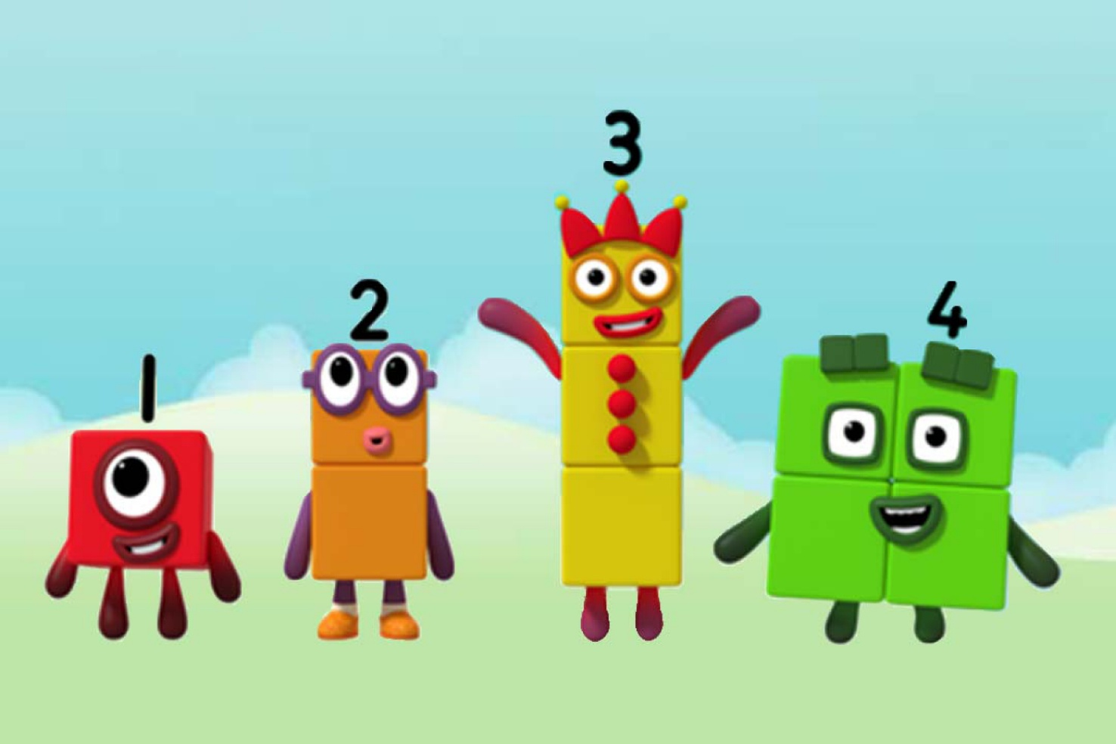
Mastering number
We have become part of a government funded programme
All children will take part in a 10 minute session 4x weekly
It focuses on developing:
fluency and recall of numbers and number facts without counting
Sense of number and the relationships and their structure
Number blocks are used to support the skills of recall and subitising

Slide 49
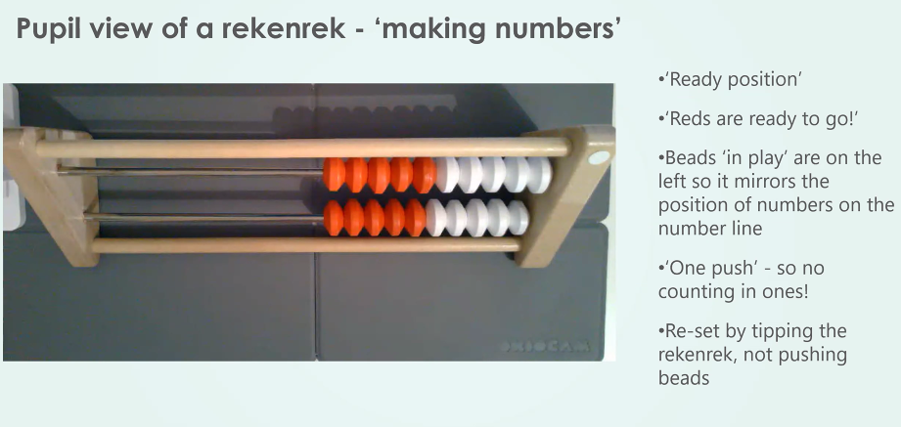

Slide 50
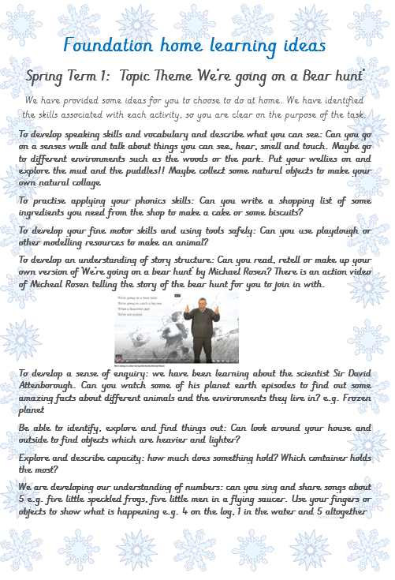
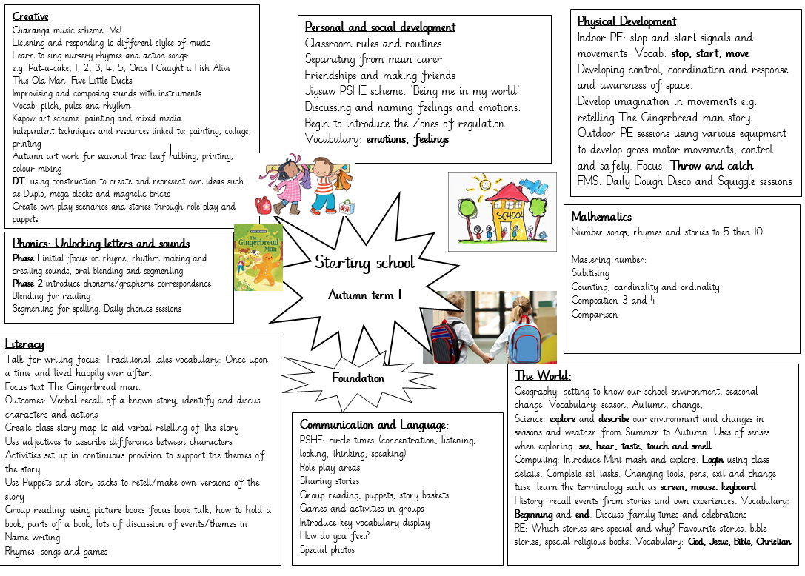
Handouts and General information
In your handouts:
Early learning goals
Actions for supporting phonics which includes letter formation
General information:
Topic webs are uploaded on to the website each term. From Autumn term 2 we will add home learning ideas as well.
Zones of Regulation meeting for parents next term
Talk slides will be made available on the website

Slide 51
Words of advice:
Please don’t overload your child at this stage. A little bit each day is enough, keep it fun and interesting. It is important to keep them enthusiastic!
Also please ask us is you are unsure of anything.
Notes:
Any questions

