Slide 1
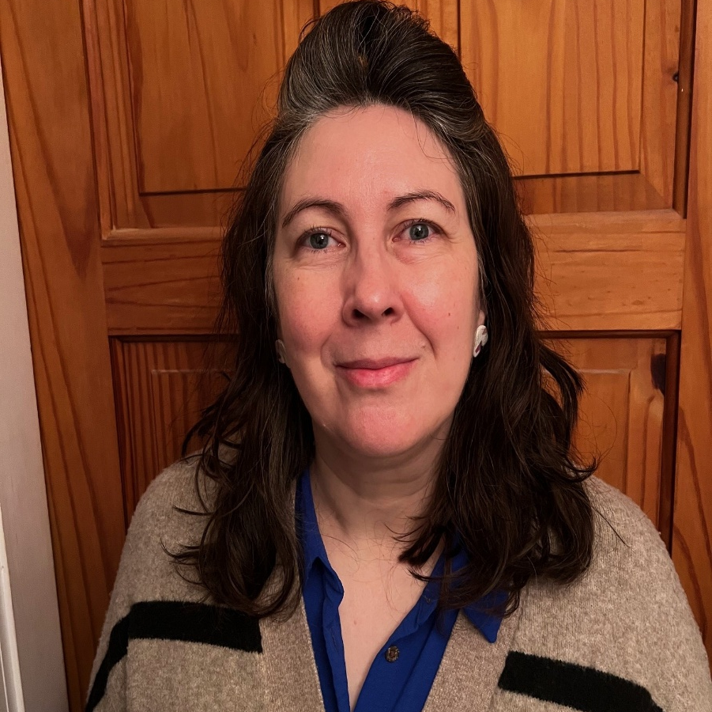
BREE LUCAS
Hello I am your School Nurse ☺
Covering all areas of health – anxiety, emotions, wellbeing, continence, sleep, healthy eating, health care plans (subject to offer) & much more!
Referrals via school staff

